Slide 1


Data Analysis Report for Fond Rouge
Shrishti Vaish, SAP
August 14, 2023

Slide 2
Agenda
Revenue and Returns Analysis by City
Sentiment Analysis and Classification in the US
Global Sentiment Analysis
Counterfeiting and Customer Satisfaction in US Locations

Slide 3
Revenue and Returns Analysis by City

Slide 4
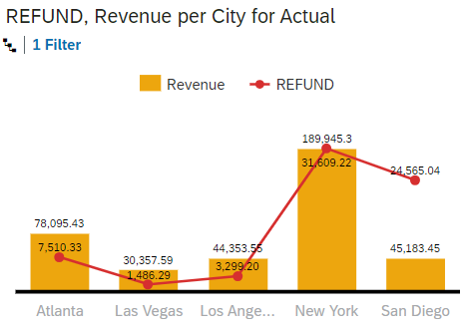
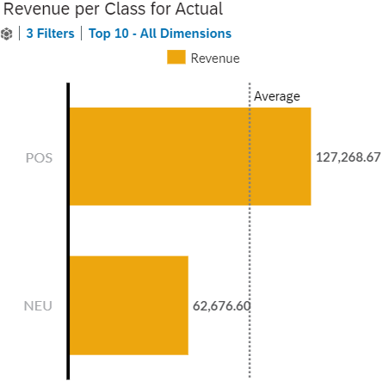
San Diego loses the highest % revenue due to returns.
New York has the highest Revenue.
POS is the top contributor, 34% above average.

Slide 5
Sentiment Analysis and Classification in the US

Slide 6
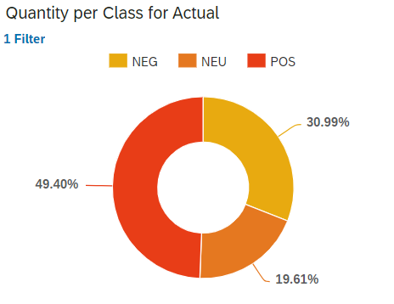
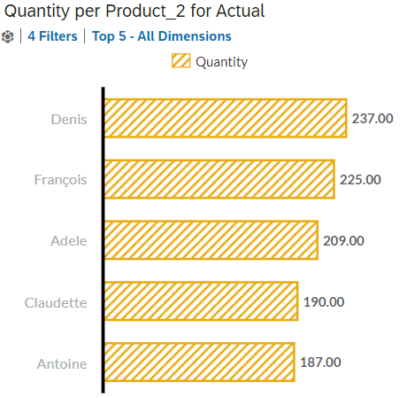
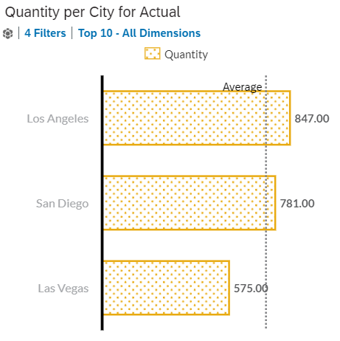
30.99% of Negative(NEG) sentiments across the US locations.
Denis is the top contributor product with the Negative sentiment
Los Angeles is the top contributor city with the Negative sentiment
Notes:
NEG Class-ifiers are used to categorize sales or transactions based on their sentiment, particularly identifying those that exhibit a negative sentiment.
This involves determining the proportion of sales that have been classified as having negative sentiment, both for the US and for the entire dataset, and presenting this percentage as an insight into customer dissatisfaction or negative feedback trends.

Slide 7
Global Sentiment Analysis

Slide 8
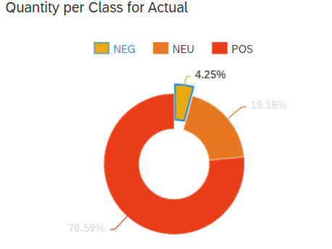
4.25% of the Global Negative sentiment score.
Denis is the top contributor product with the Negative sentiment globally
Los Angeles is the top contributor city with the Negative sentiment globally

Slide 9
Counterfeiting and Customer Satisfaction in US

Slide 10
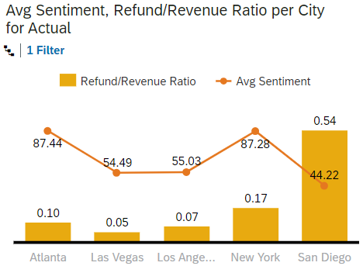
Los Angeles & Las Vegas are the 2 cities where the returns are lower than 20%, but the Sentiment is low (under 65))
Fond Rouge does not have a problem in all of its American locations because places like Atlanta and New York have less than 20% of return/revenue ratio and their Avg. sentiment score is above.
Counterfeit is not the only problem, however, despite having low returns in Atlanta and New York, its important to investigate other reasons for customer dissatisfaction.

Slide 11

Thank you.
Contact information:
Shristi Vaish
SAP Consultant

